Slide 1
Holocaust Memorial Day

Slide 2
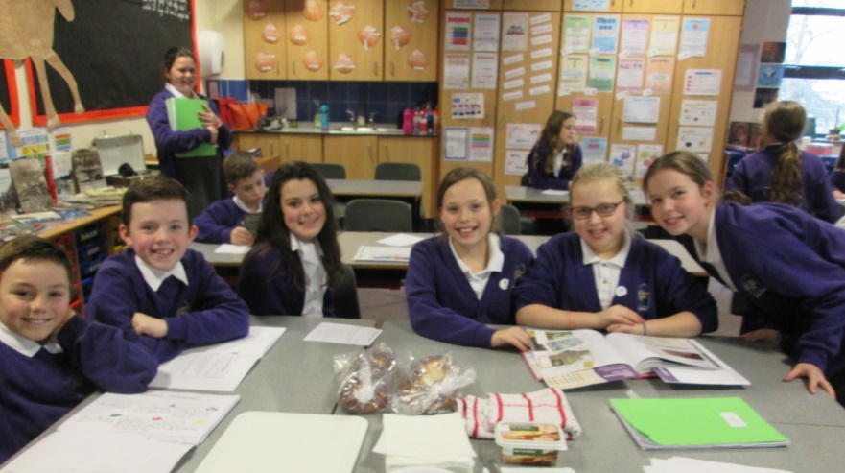
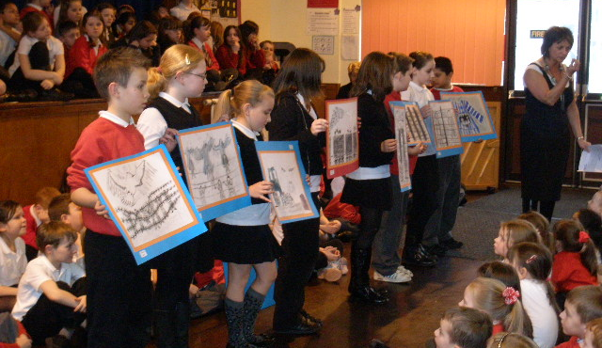
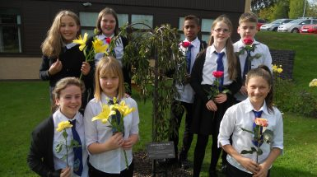
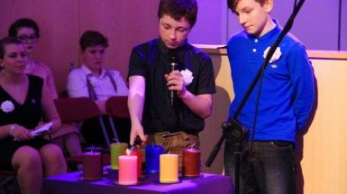
Holocaust Memorial Day is on
27 January each year
Middle © Woodside Primary School

Slide 3
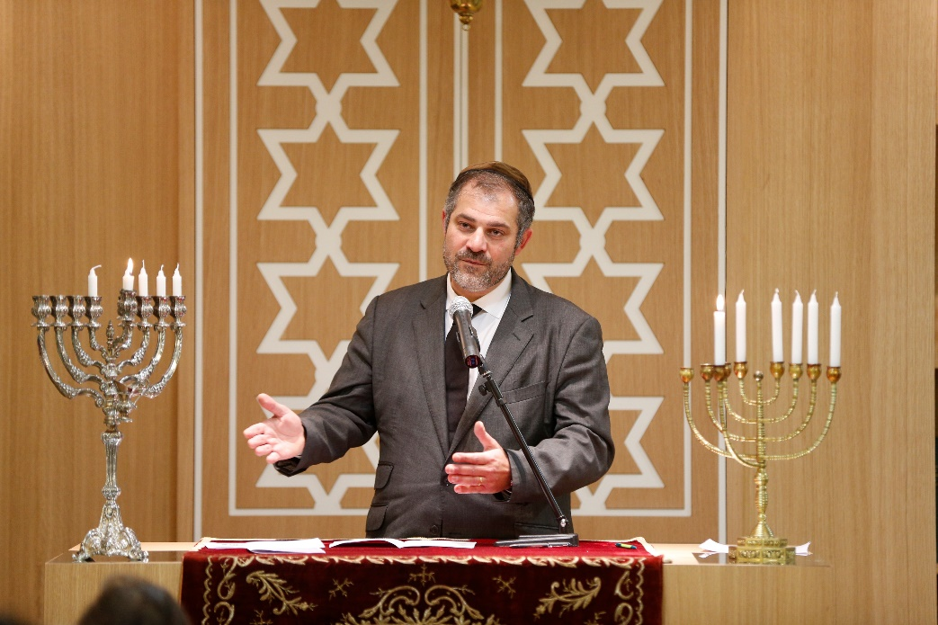
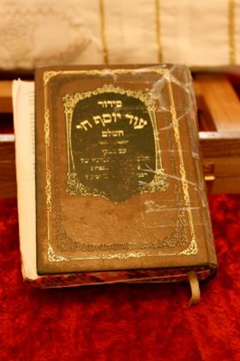
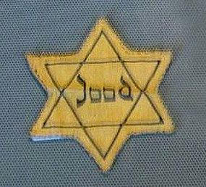
Jewish people
Darfur in Sudan
During the Holocaust
Jewish people were
forced to wear a yellow
star on their clothes.
A Rabbi in a Synagogue
The Torah
By Azuelos5 - CC BY-SA 3.0
By Urek Meniashvili CC BY-SA 3.0
CC-BY-SA-3.0 via Wikimedia Commons

Slide 4
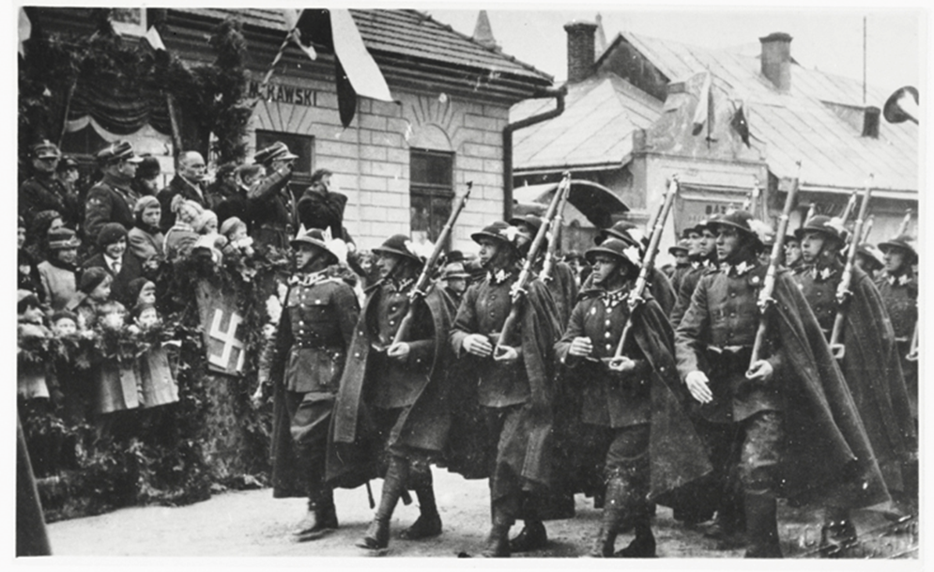
The Nazis
Darfur in Sudan
Nazi laws in Germany meant
that Jewish people:
Couldn’t go to school
Couldn’t marry people who weren’t Jewish
Weren’t allowed to vote
Weren’t allowed to do many jobs
Nazi soldiers
For example, when Otto Deutsch was 10 years old, there
were new laws in Austria where he lived:
‘A Jew mustn’t own a bicycle, nor a pet. I went to the local
park and saw a sign saying Jews forbidden – I wasn’t
allowed to kick my football about in the park.’

Slide 5
Discrimination
Darfur in Sudan

Slide 6
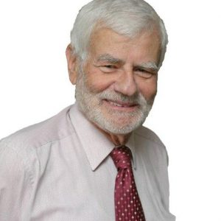
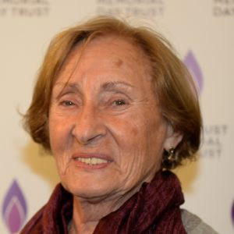
The Holocaust
Darfur in Sudan
The Nazis killed 6 million Jewish people during the Holocaust.
Anne Frank lived in hiding when the Nazis tried to take her family away.
They hid for two years before being found.
Bernd Koschland came to England as a child to escape the Nazis.
He had to leave his family behind.
Susan Pollack survived horrible treatment by the Nazis. Lots of her
family were killed.

Slide 7
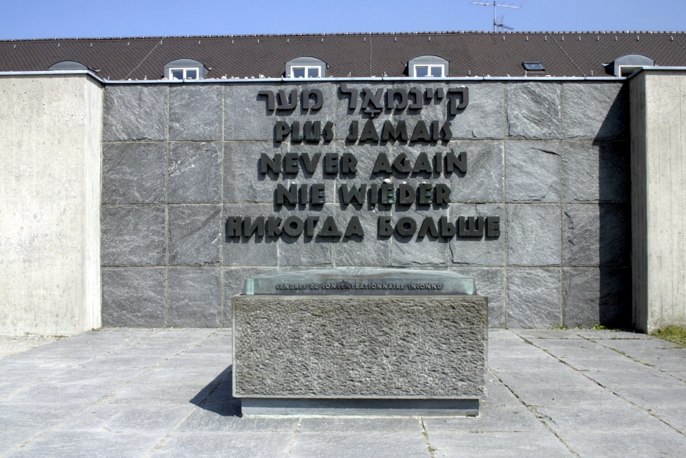
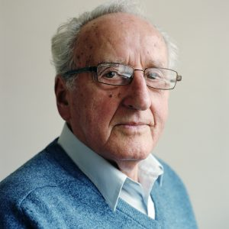
After the Holocaust
Darfur in Sudan
Ivor Perl talks to lots of groups
about his experiences during the
Holocaust.
Memorial at Dachau concentration camp

Slide 8
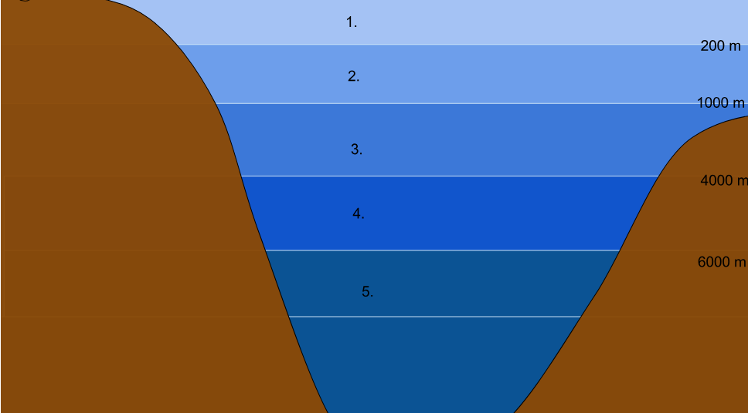
Poetry reading
Darfur in Sudan
Hate
Love
By Awakening Conscience CC BY-SA 4.0
Taken by fir0002 Wikimedia Commons

Slide 9
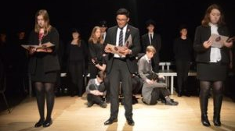
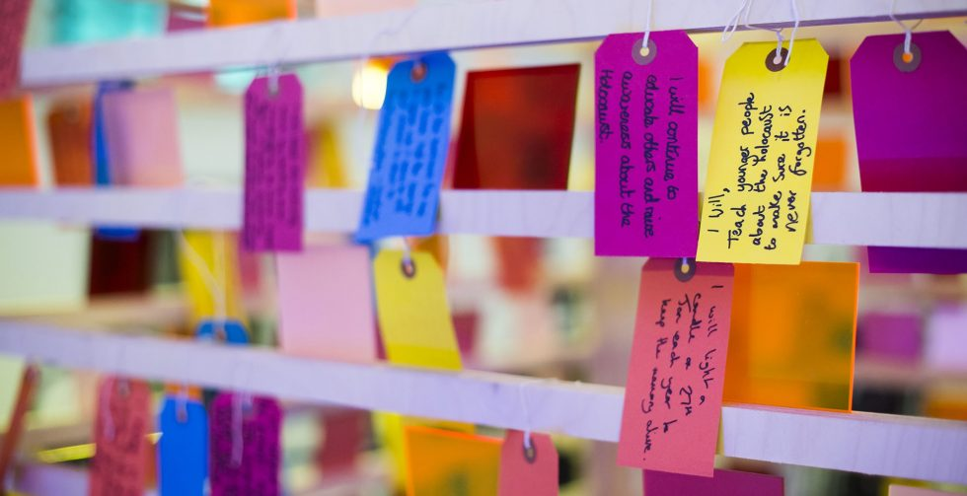
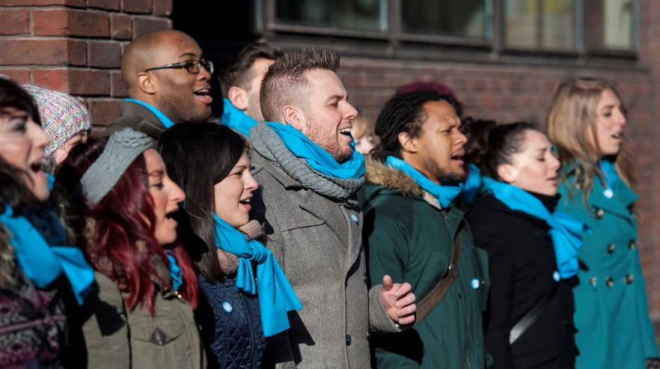
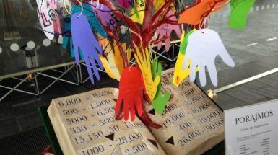
What happens on Holocaust Memorial Day?
Darfur in Sudan
Local activities around the country

Slide 10
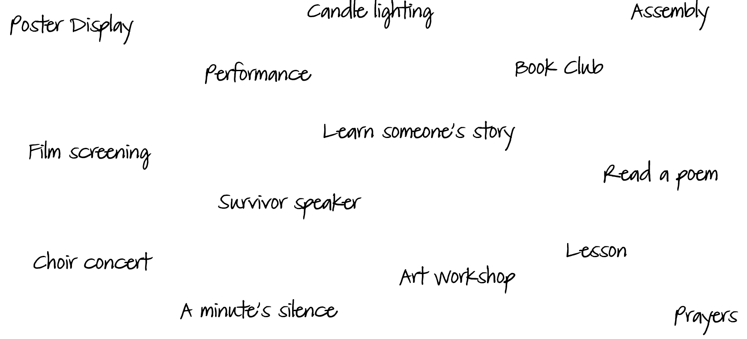
What can we do?
Darfur in Sudan

Slide 11
Your voice is amazing
Darfur in Sudan

Slide 12
A prayer for all of us
Here in our school
Let us be peaceful and loving at all times.
Let our rooms be full of happiness and respect for each other.
Let love be in our hearts
With kindness and compassion for all.
Let us remember
In learning together,
We grow together
And succeed together.
Amen

Slide 13
Holocaust Memorial Day

