Slide 1


Our internet, our choice
Understanding consent in a digital world
Assembly for ages 7-11

Slide 2















How do YOU use the internet?

Slide 3


What is consent?
Consent is another word for permission.
We need to ask for permission for some things and give permission for others, when we’re online as well as offline.
Let’s look at some examples…
Notes:
Emoji provided free by EmojiOne: https://www.emojione.com/

Slide 4


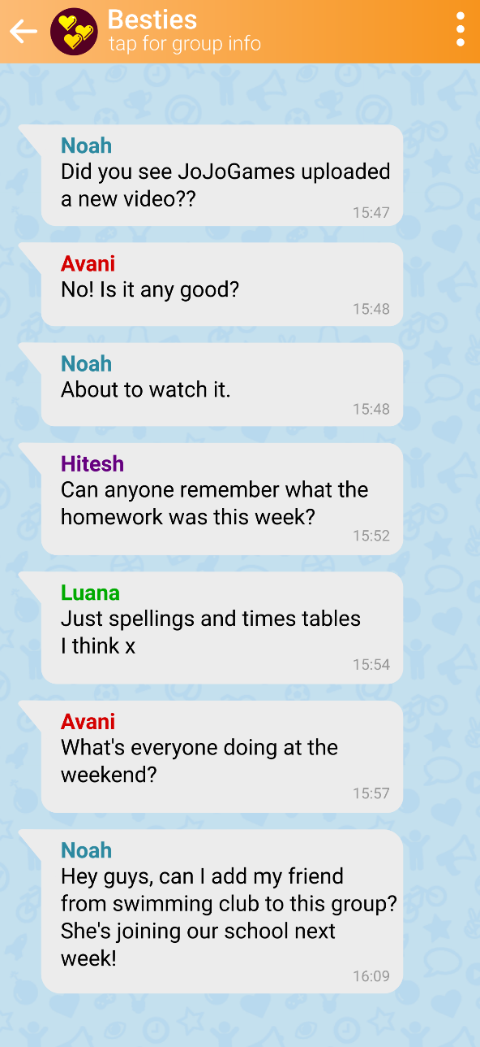
When do we need
consent with friends?
It’s important to check how people feel about an action before you do it.
Can you think of any other online examples like this?

Slide 5

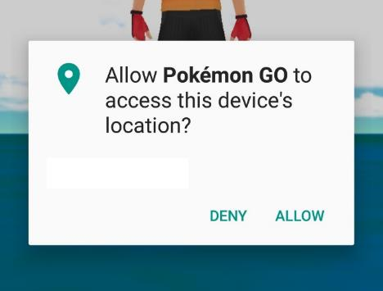
Why do organisations sometimes ask you for consent?
Sometimes organisations will ask permission before they do something that might affect you or your account – for example, collecting your personal information.
Can you think of any other online examples like this?

Slide 6

Making positive choices
Making positive choices
Asking for and giving permission is an opportunity to make a choice about your life online.
You have the power to make a positive choice but that choice could take many forms.
Think about the questions on the next few slides, what do you think is the right choice for each one?
Notes:
Emoji provided free by EmojiOne

Slide 7
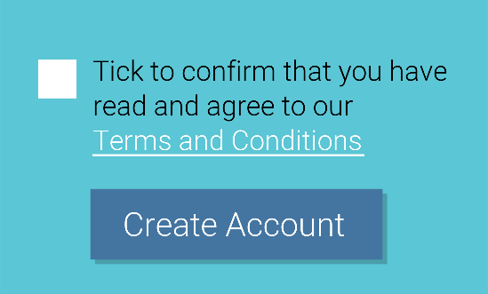
Permission Mission
Making positive choices
You’re signing up for a new online gaming account when you’re given the following choice.
a
Speak to an adult
b
What do you do next?
Tick the box and click ‘Create Account’
c
Click on ‘Terms and Conditions’ to read what they say
d
Something else

Slide 8


Permission Mission
Making positive choices
You took a silly photo with your friend and want to send it to your cousin who lives abroad.
a
What do you do next?
Send the photo! Your friend won’t mind
b
Don’t send it. It’s not fair on your friend who looks silly!
c
Ask your friend if they mind you sharing the photo with your relative
d
Something else
Notes:
Emoji provided free by EmojiOne

Slide 9
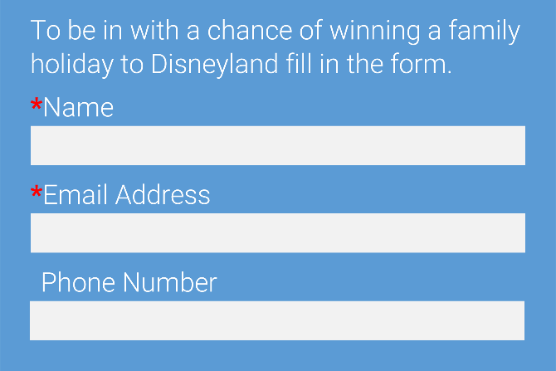
Permission Mission
Making positive choices
You’re entering an online competition and are asked to fill in this form.
a
Fill in all the details marked with the *
b
What do you do next?
Fill in every detail on the form
c
Speak to an adult
d
Something else

Slide 10

Permission Mission
Making positive choices
Your parents gave you permission to play a game rated 12+ but one day your friend comes over, who doesn’t have permission to play it.
a
Ask your parents if it’s still okay
b
What do you do next?
Choose a different game to play instead
c
Play the game anyway – it’s not even scary!
d
Something else
Notes:
Emoji provided free by EmojiOne

Slide 11
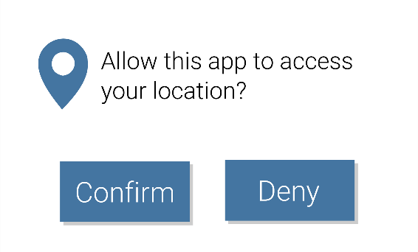
Permission Mission
Making positive choices
You’ve installed a new gaming app on your mum’s phone when a pop-up appears.
a
Click confirm
b
What do you do next?
Ask your Mum
c
Click deny
d
Something else

Slide 12





Our internet, our choice
If something makes you worried, uncomfortable or upset it’s always okay to say no.
If you’re sure you’re happy with what will happen next then it’s okay to say yes.
If what you’re doing online might affect somebody else, always ask their permission first.
If you’re unsure or need further support then speak to an adult for help and advice.

Slide 13

Our internet, our choice

Slide 14

Our internet, our choice
Understanding consent in a digital world

