Slide 1
Safer Routes
Information Pack.
Item 3
Information for teachers, pupils, parents and carers.

Slide 2
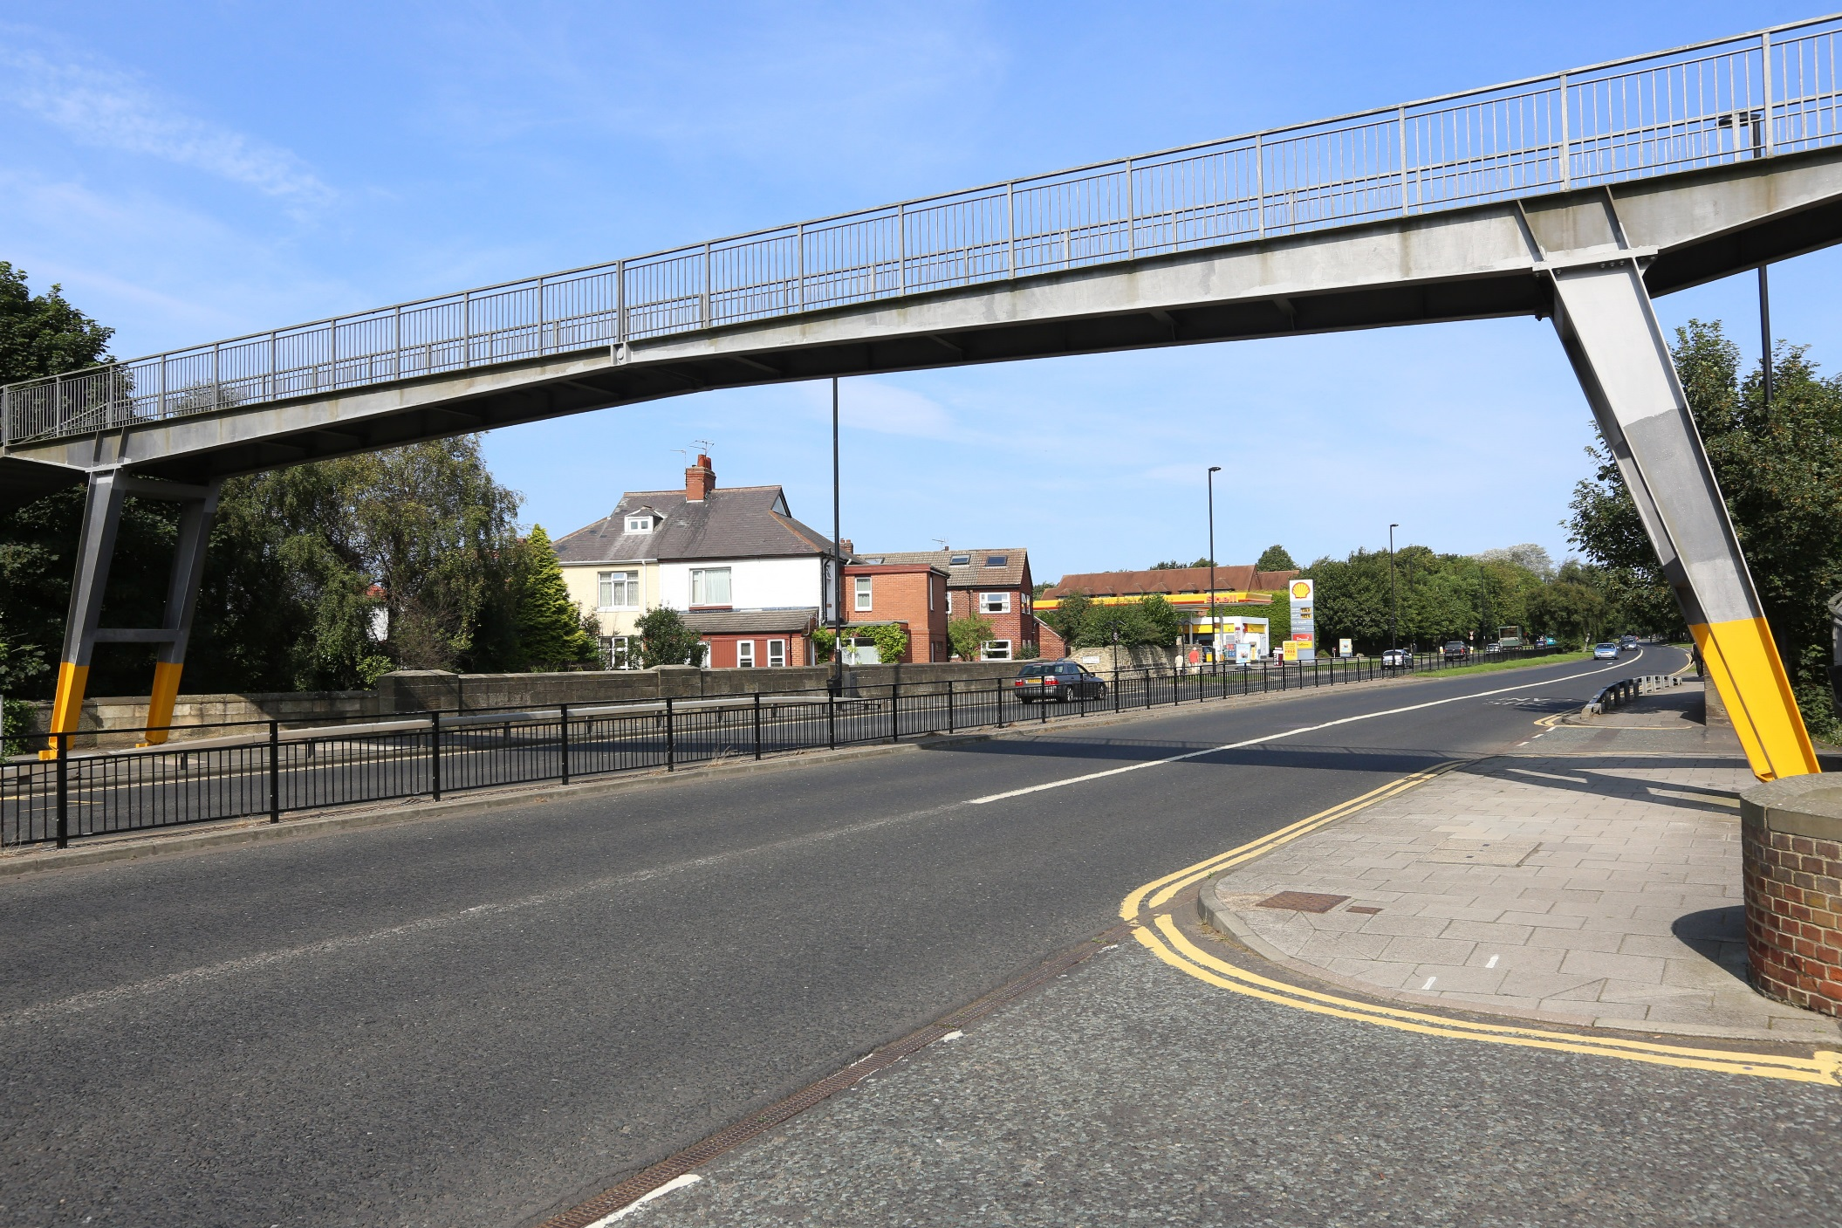
Footbridge

Slide 3
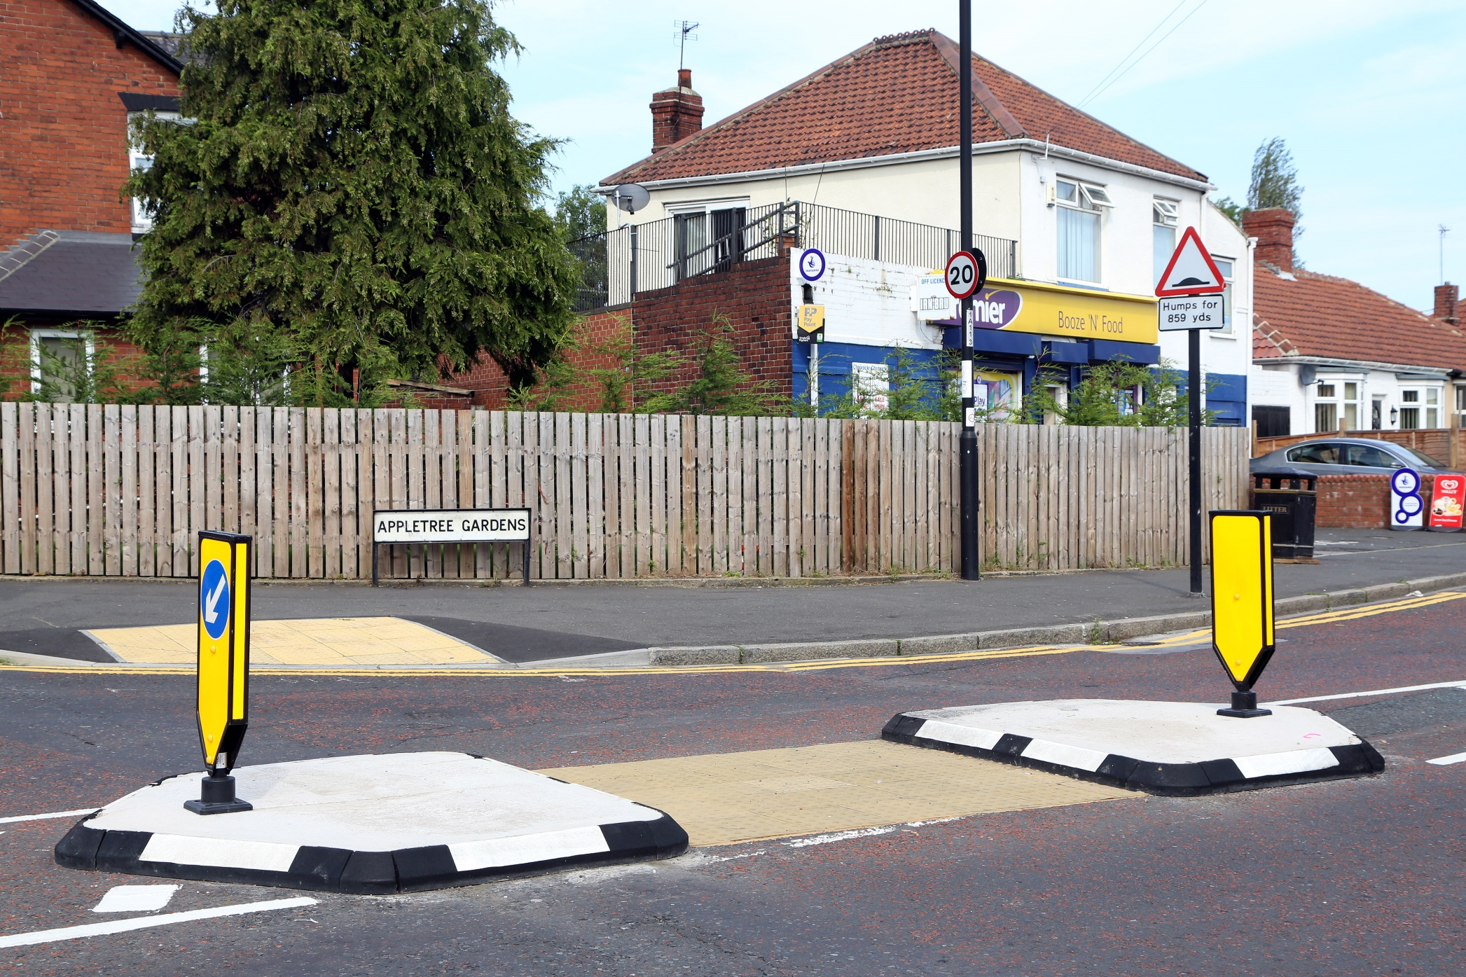
Traffic Island/Pedestrian Refuge

Slide 4
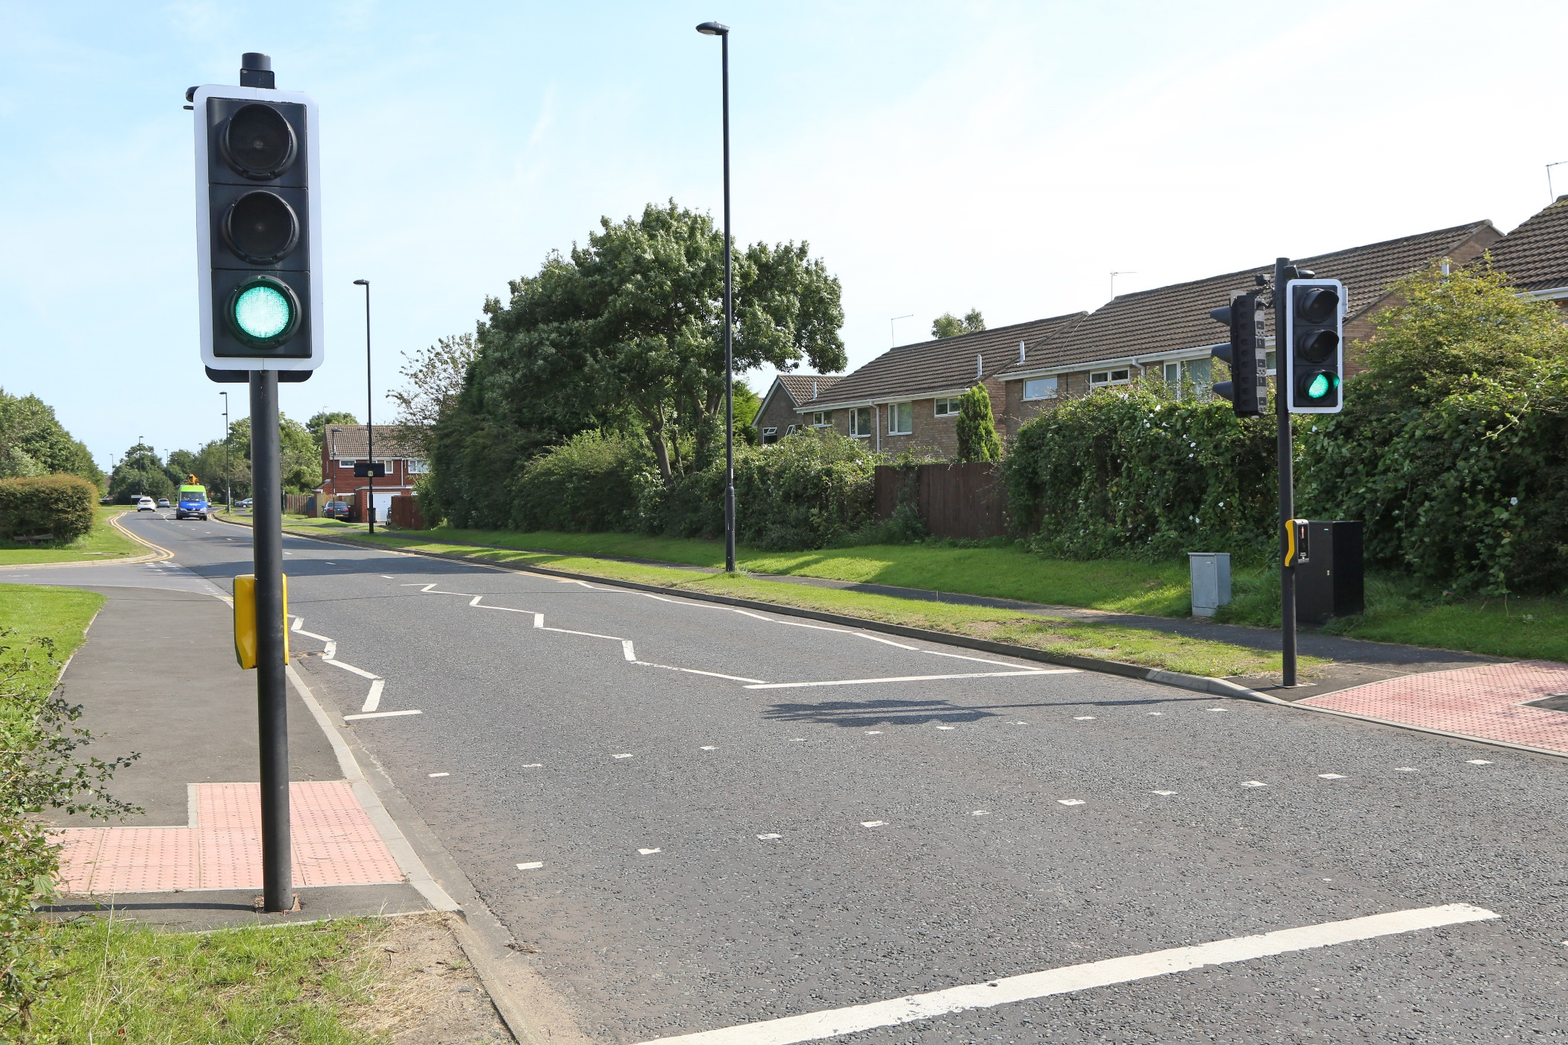
Puffin Crossing

Slide 5
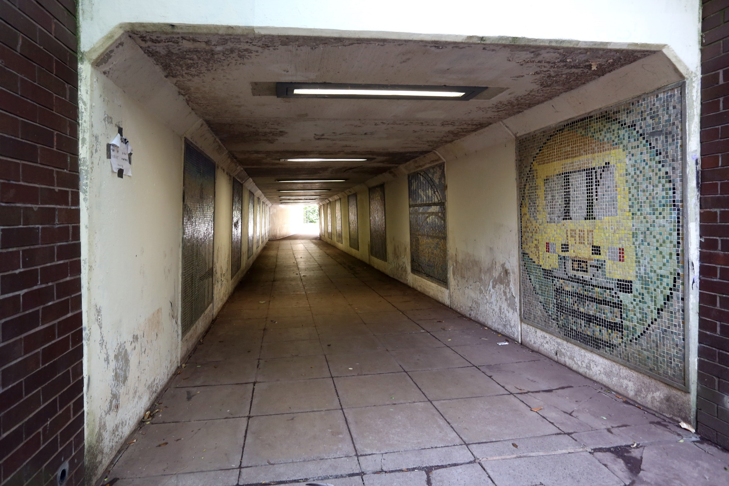
Subway

Slide 6
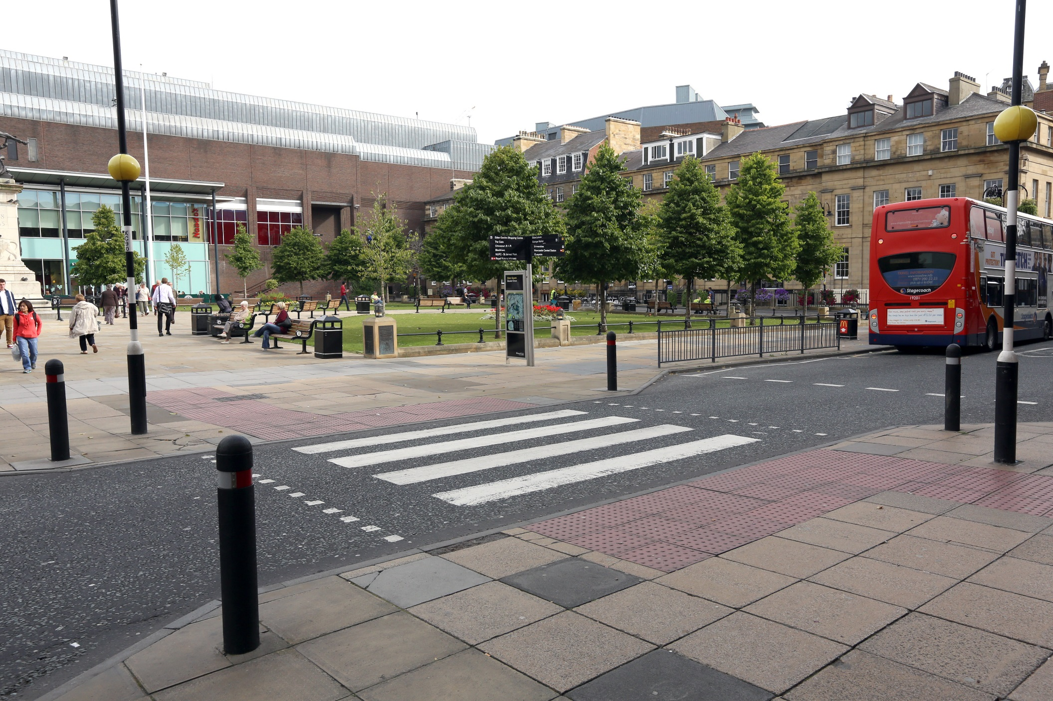
Zebra Crossing

Slide 7
For further advice, training and support, please contact the Road Safety Team at road.safety@newcastle.gov.uk or 0191 2115961

